Slide 1

SALARY PREDICTION
GLASSDOOR JOBS 2017-2018
PART I: Visual Data Exploration
PART II: Linear Regression Models
PART III: Logistic Regression Models
Sheena Knott

Slide 2

PART I
What Are the Main Influencers of Salary?

Slide 3
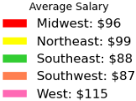
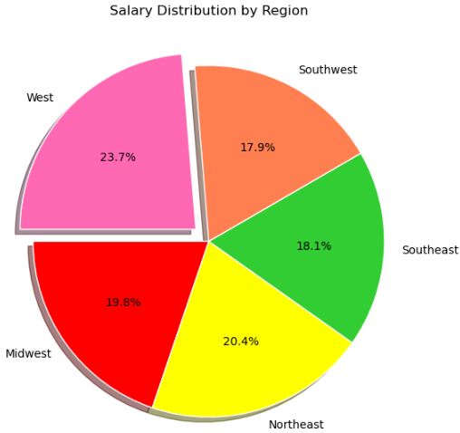
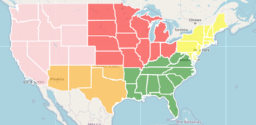
REGIONS

Slide 4

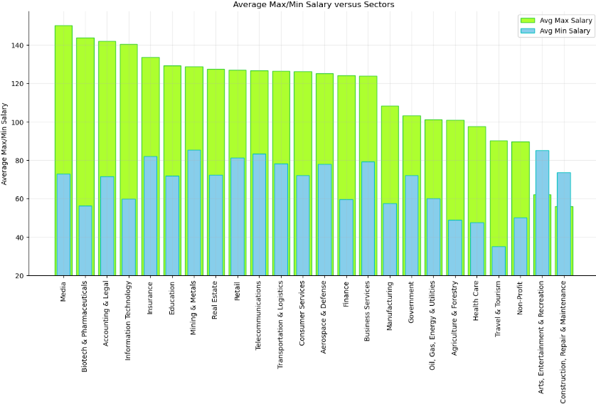
SECTORS

Slide 5

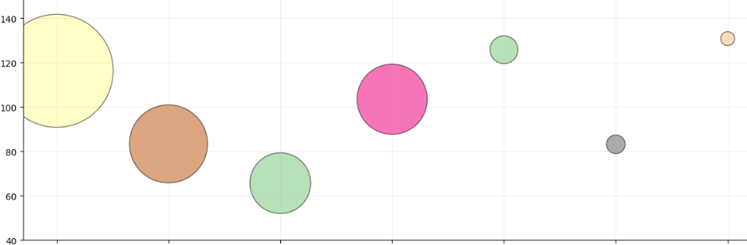
NUMBER OF JOBS FOR EACH TITLE
Average Salary
Data Analyst
Manager
Director
Data Scientist
Research Scientist
Data Engineer
Machine Learning Engineer

Slide 6
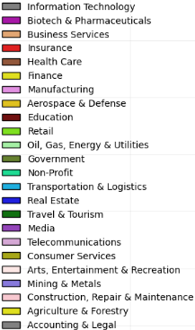
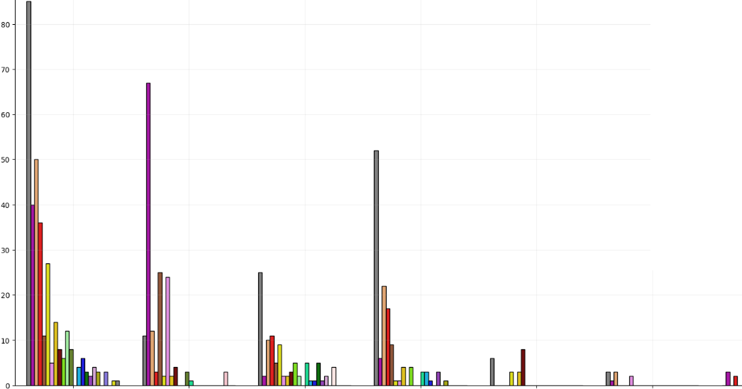
NUMBER OF JOBS
Job Numbers
Data Scientist
Research Scientist
Data Analyst
Data Engineer
Machine Learning Engineer
Manager
Director

Slide 7
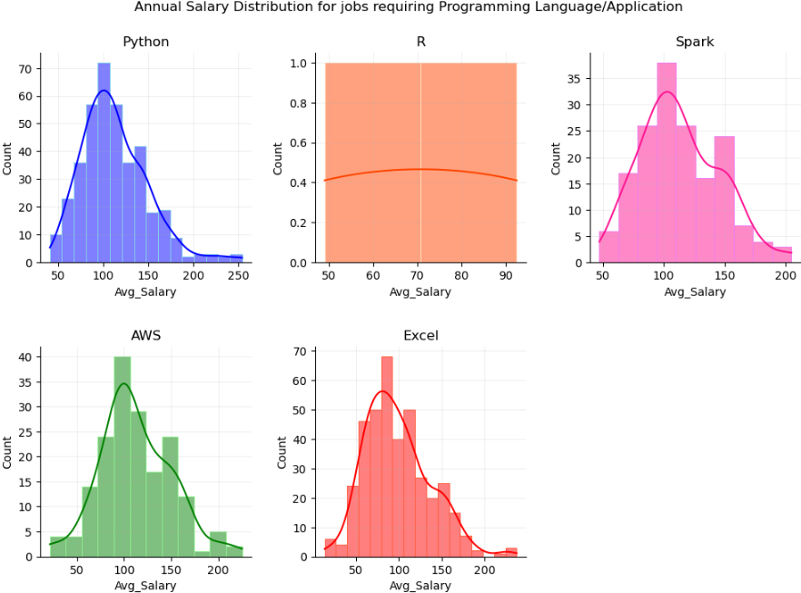
PROGRAMMING SKILLS
Median Salary
Python: $107k
R: $70k
Spark: $108k
AWS: $107k
Excel: $92k

Slide 8

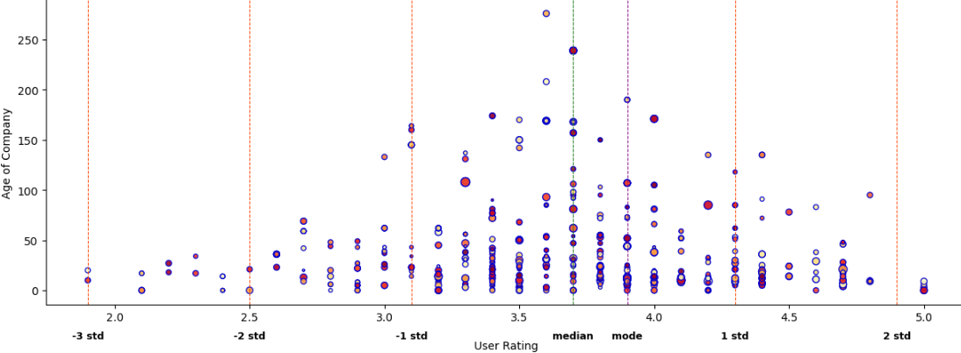
COMPANY AGE, USER RATINGS

Slide 9
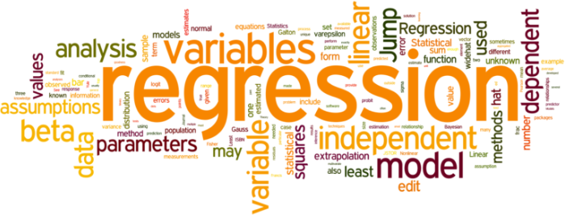
PART II
Linear Regression

Slide 10

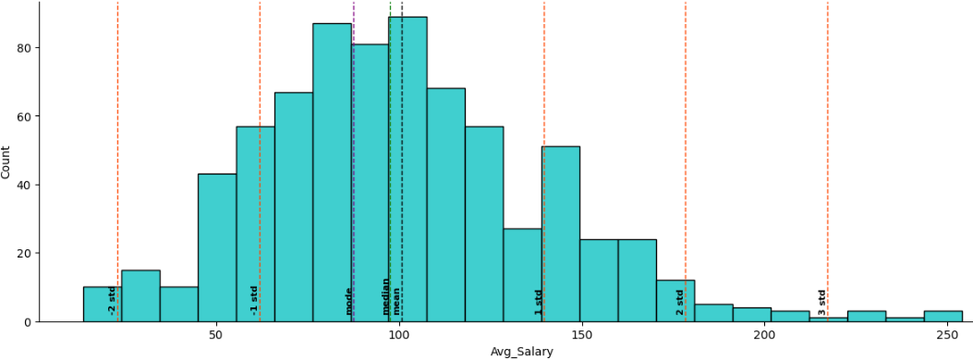
SALARY DISTRIBUTION

Slide 11

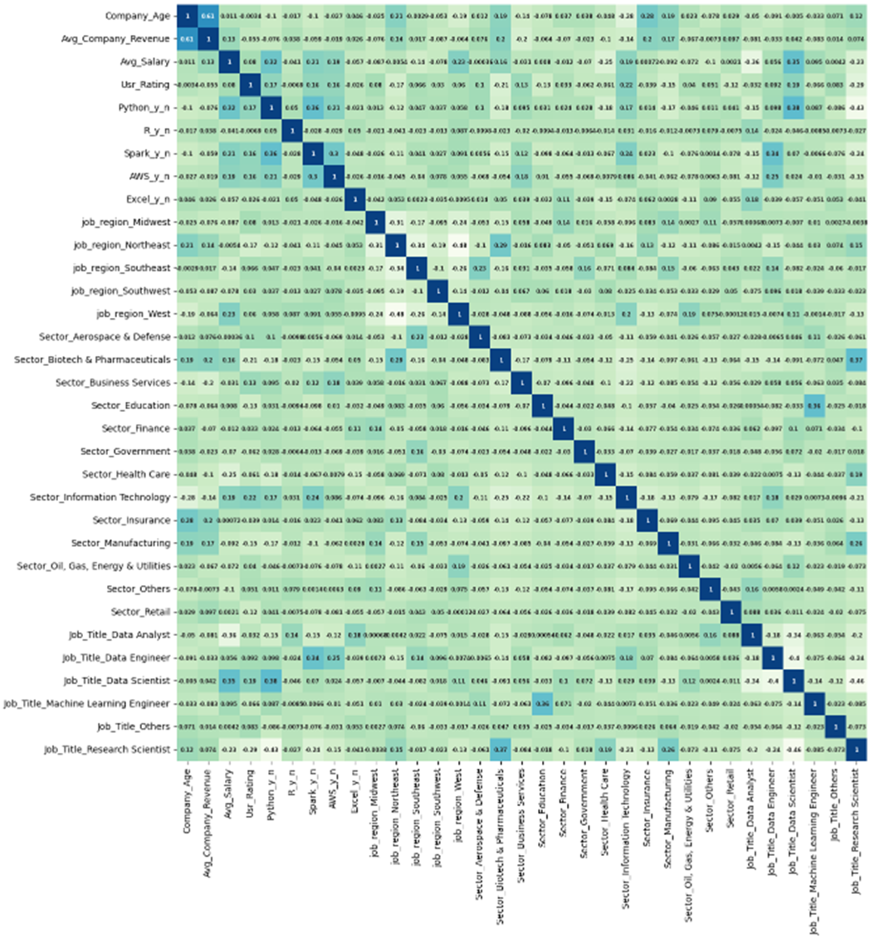
CORRELATION MATRIX

Slide 12

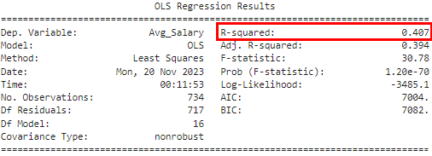
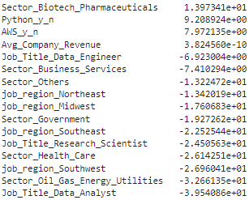
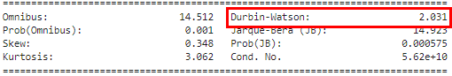
Ordinary Least Squares OLS REGRESSION
Coefficients of Features

Slide 13

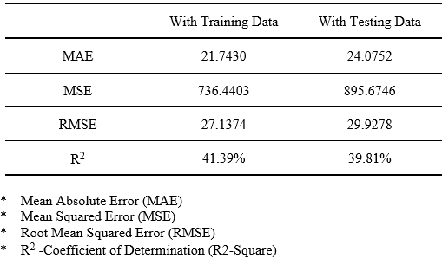
COMPARISON OF MODEL PERFORMANCE
Error Comparison Using OLS Regression Model

Slide 14
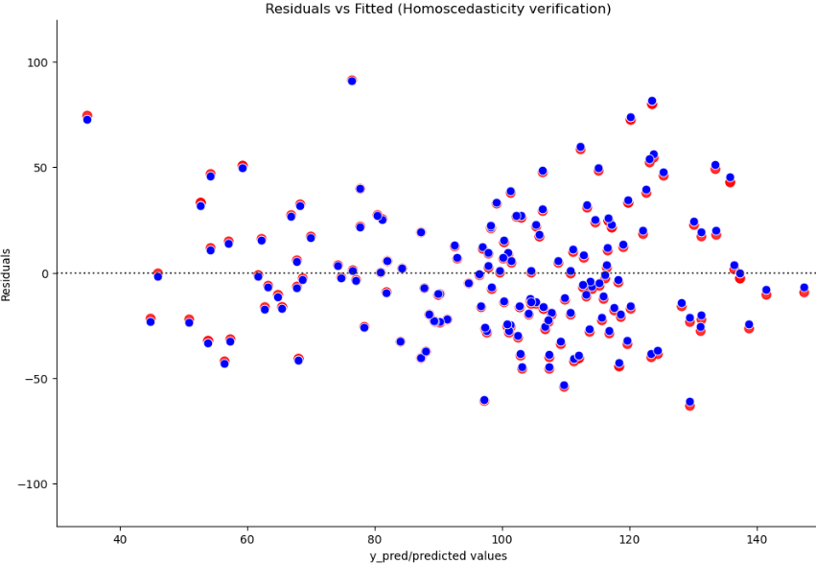
HOMOSCEDASTICITY TEST

Slide 15

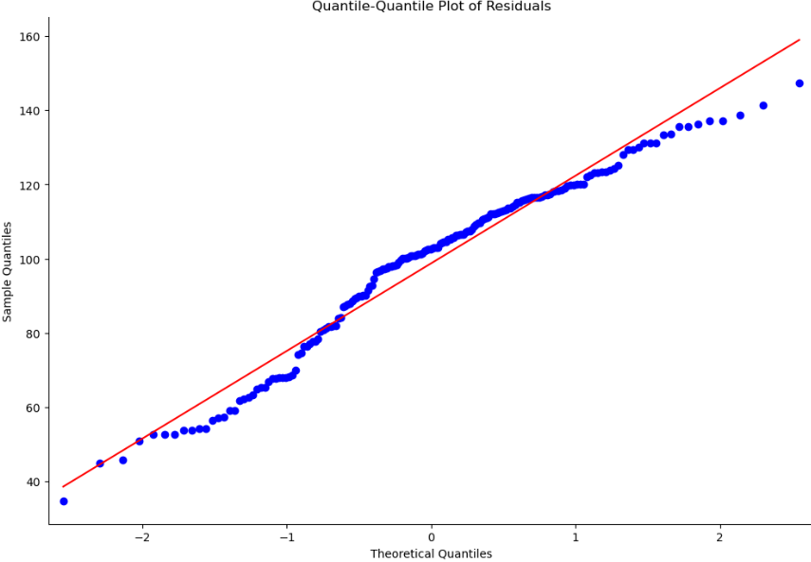
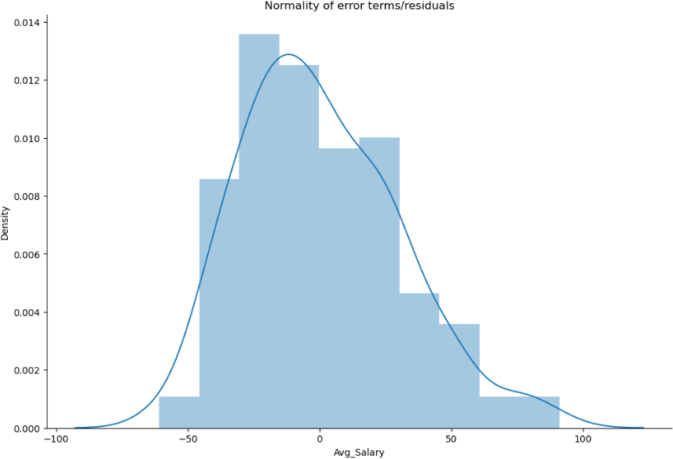
QQ PLOT
RESIDUAL PLOT

Slide 16

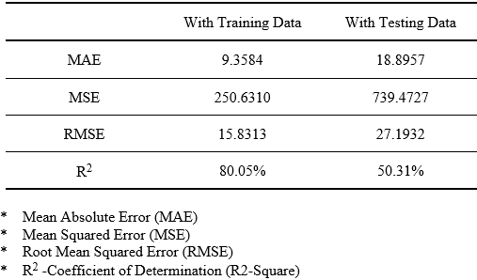
COMPARISON OF MODEL PERFORMANCE
Error Comparison Using Decision Tree Regression Model

Slide 17
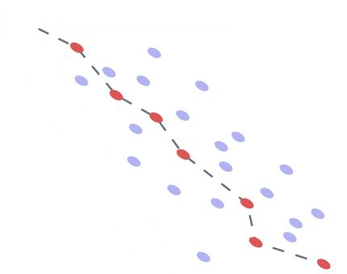
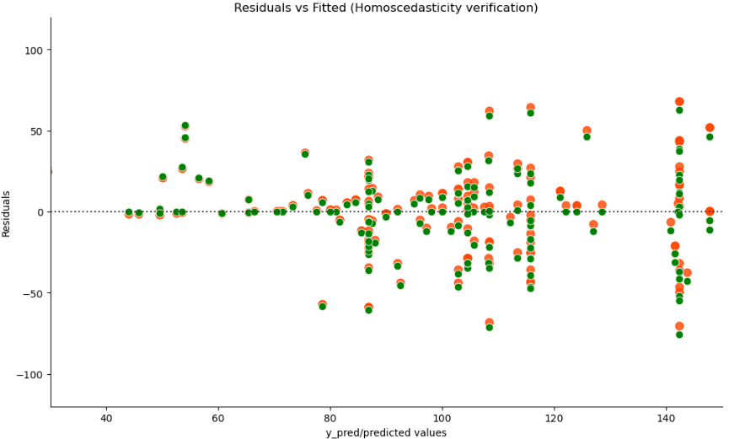
HOMOSCEDASTICITY TEST

Slide 18

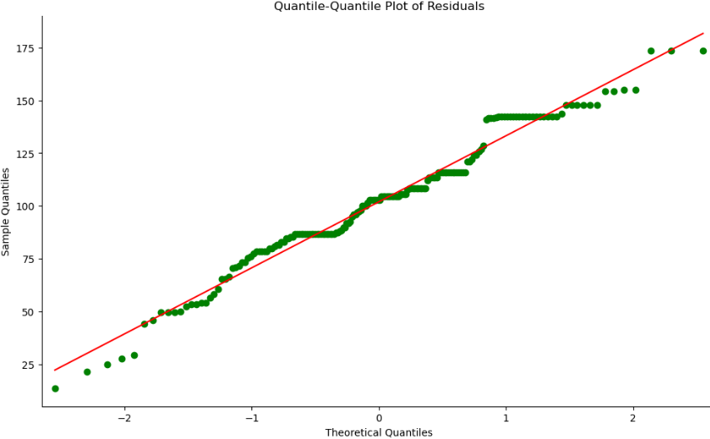
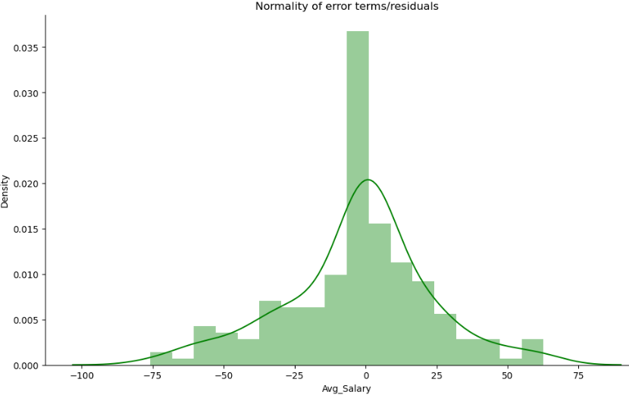
QQ PLOT
RESIDUAL PLOT

Slide 19

CONCLUSION
Linear Regression Model
R² Value was 39.8% with OLS Model
R² Value improved to 50.3% with Decision Tree Regressor
For this Data Set, Decision Tree Regressor Model is a better Predictor of Salary compared to the OLS Model.

Slide 20
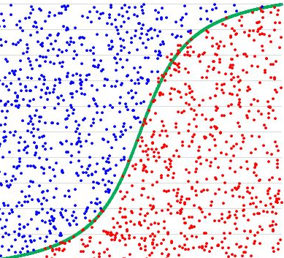
PART III
Logistic Regression

Slide 21

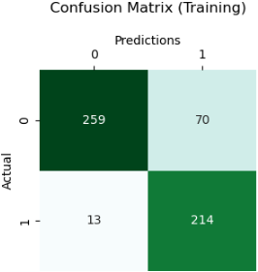
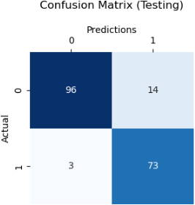
DECISION TREE CLASSIFICATION MODEL
Model Evaluation Comparison
Accuracy Score:
0.9086021505376344
Accuracy Score:
0.8507194244604317

Slide 22

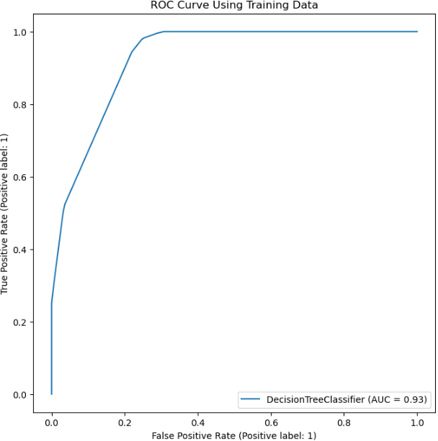
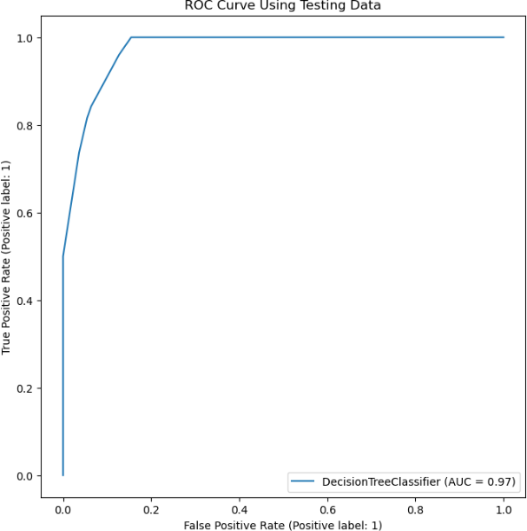
RECEIVER OPERATING CHARACTERISTIC (ROC)

Slide 23

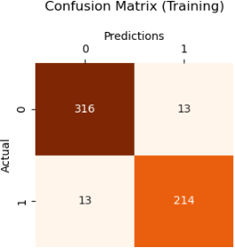
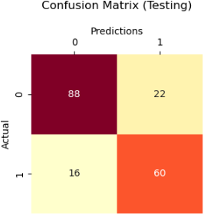
0.7903225806451613
RANDOM FOREST CLASSIFICATION MODEL
Model Evaluation Comparison
Accuracy Score:
0.9532374100719424
Accuracy Score:
0.7956989247311828

Slide 24

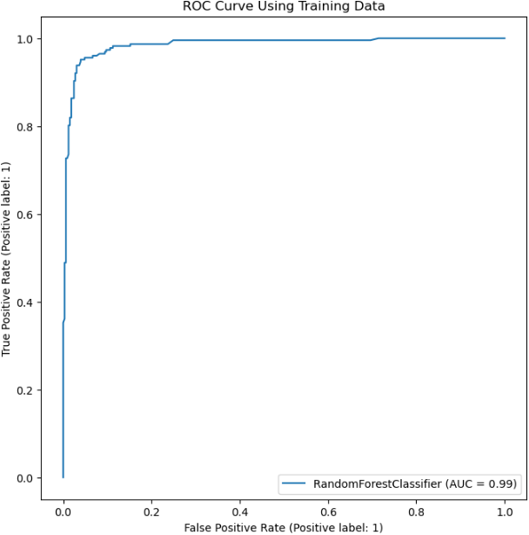
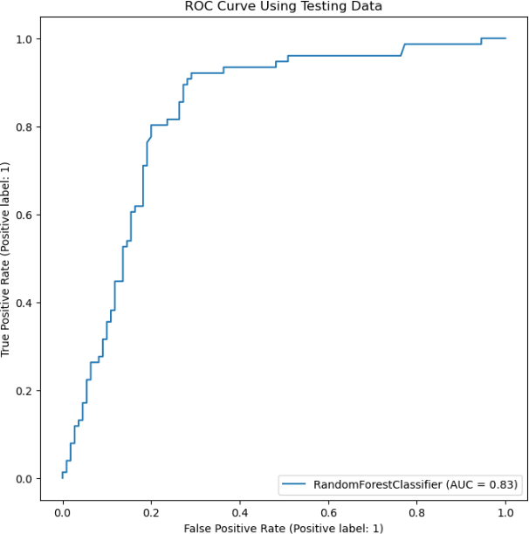
RECEIVER OPERATING CHARACTERISTIC (ROC)

Slide 25

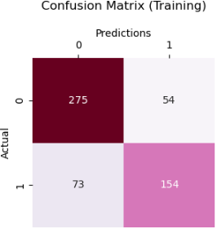
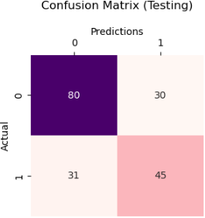
‘LBFGS’ OPTIMIZATION ALGORITHM FOR LOGISTIC REGRESSION
Model Evaluation Comparison
Accuracy Score:
0.6720430107526881
Accuracy Score:
0.7715827338129496

Slide 26

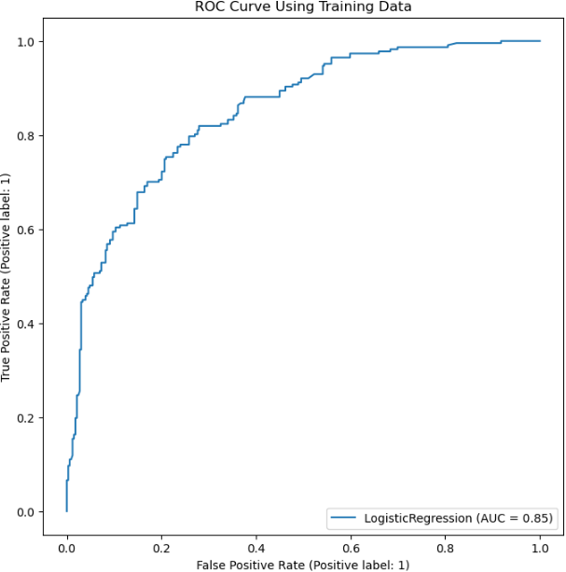
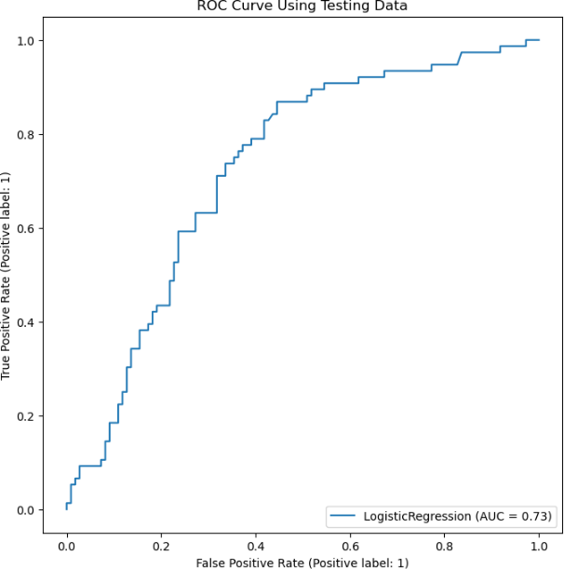
RECEIVER OPERATING CHARACTERISTIC (ROC)

Slide 27

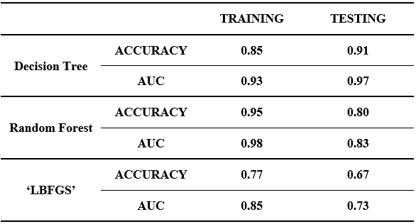
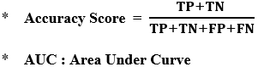
COMPARISON
LOGISTIC CLASSIFICATION MODELS

Slide 28
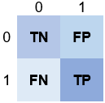
CONCLUSION
Logistic Classification Model
Objectives:
Lower FN Number in Confusion Matrix
Improve Accuracy, AUC values
For this Data Set, Random Forest Classifier is the best Predictor of Salary Classification.

Slide 29

RESOURCES
https://www.kaggle.com/datasets/thedevastator/jobs-dataset-from-glassdoor
https://www.geeksforgeeks.org/qqplot-quantile-quantile-plot-in-python/
https://stackoverflow.com/questions/48009614/quantile-quantile-plot-using-python-statsmodels-api

